Slide 2
Practical IoT Hacking: Introduction to Multi-Band Hacking with the CatSniffer
Eduardo Wero (@foreverwero) / Paulino Calderon (@calderpwn)

Slide 3

Workshop resources:
https://bit.ly/3Dsyqol

Slide 4
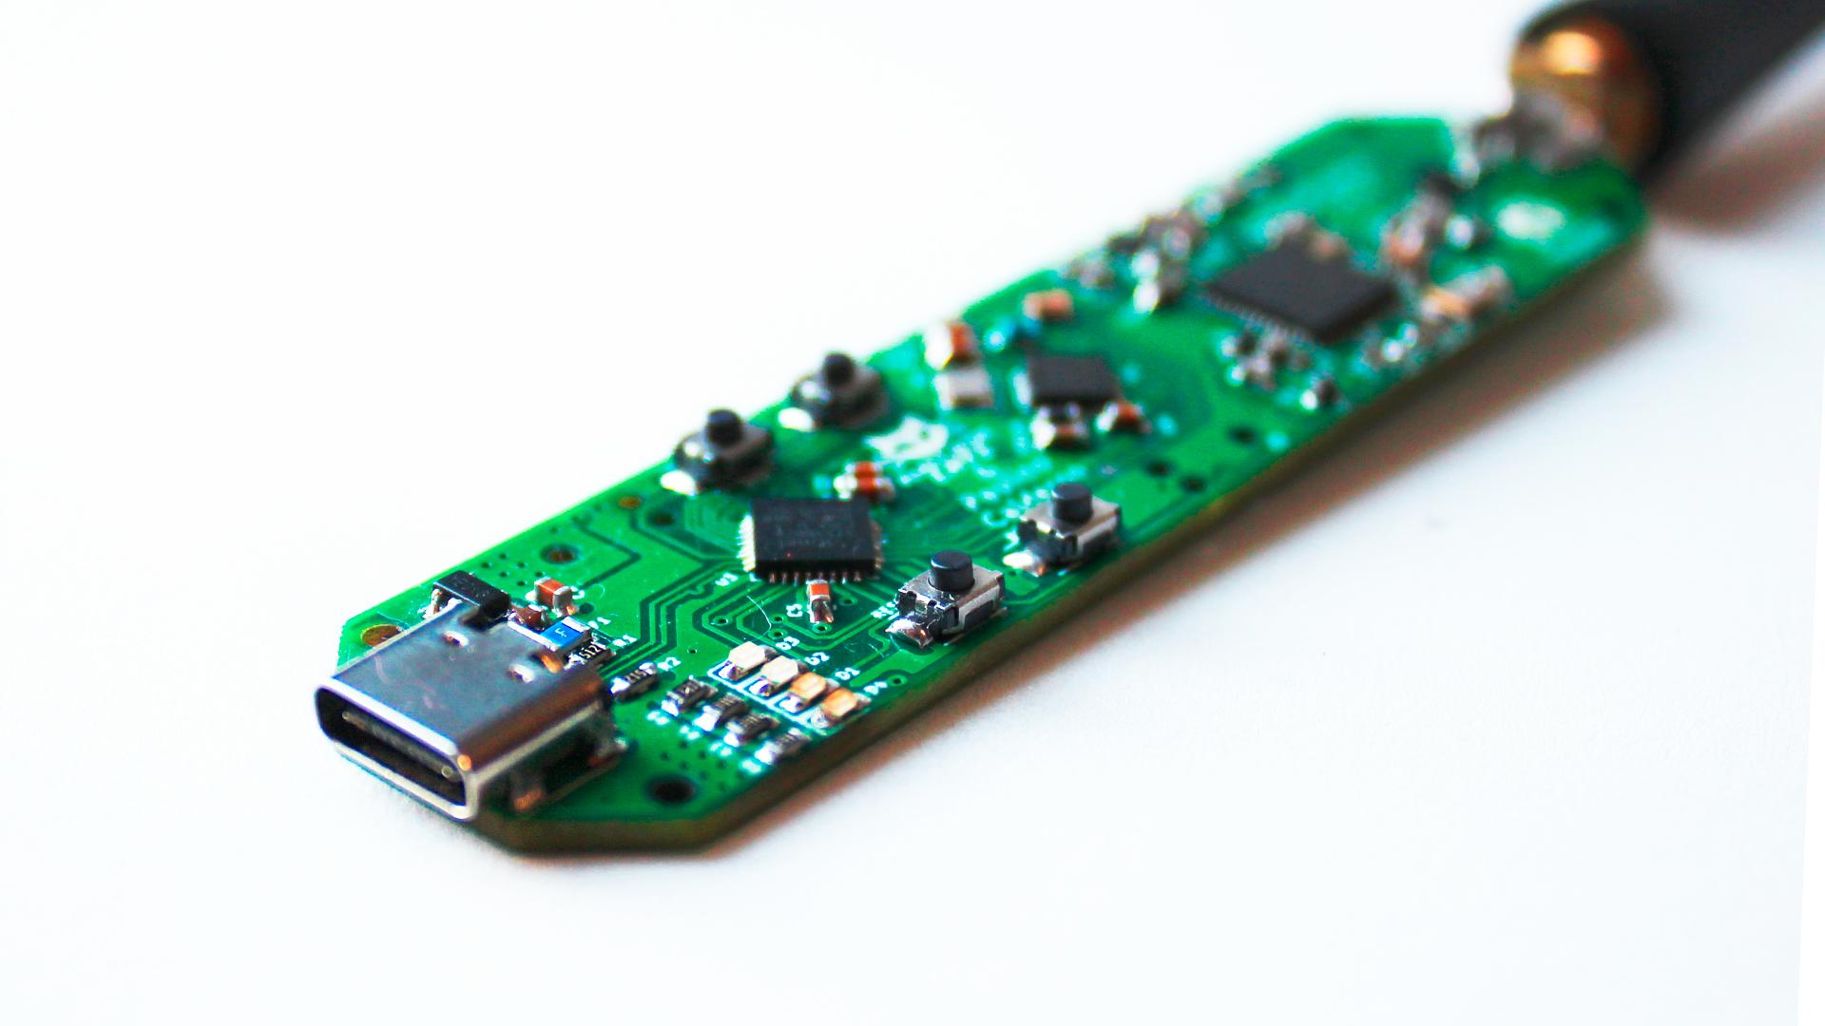
CatSniffer
CatSniffer (😼) is an innovative, multi-protocol, multi-band open source circuit board made for sniffing, communicating, and attacking IoT (Internet of Things) devices. It was designed as a highly portable USB stick that integrates TI CC1352, Semtech SX1262, and Microchip SAMD21E17 (V1.x and V2.x)/RP2040 (V3.x).

Slide 6
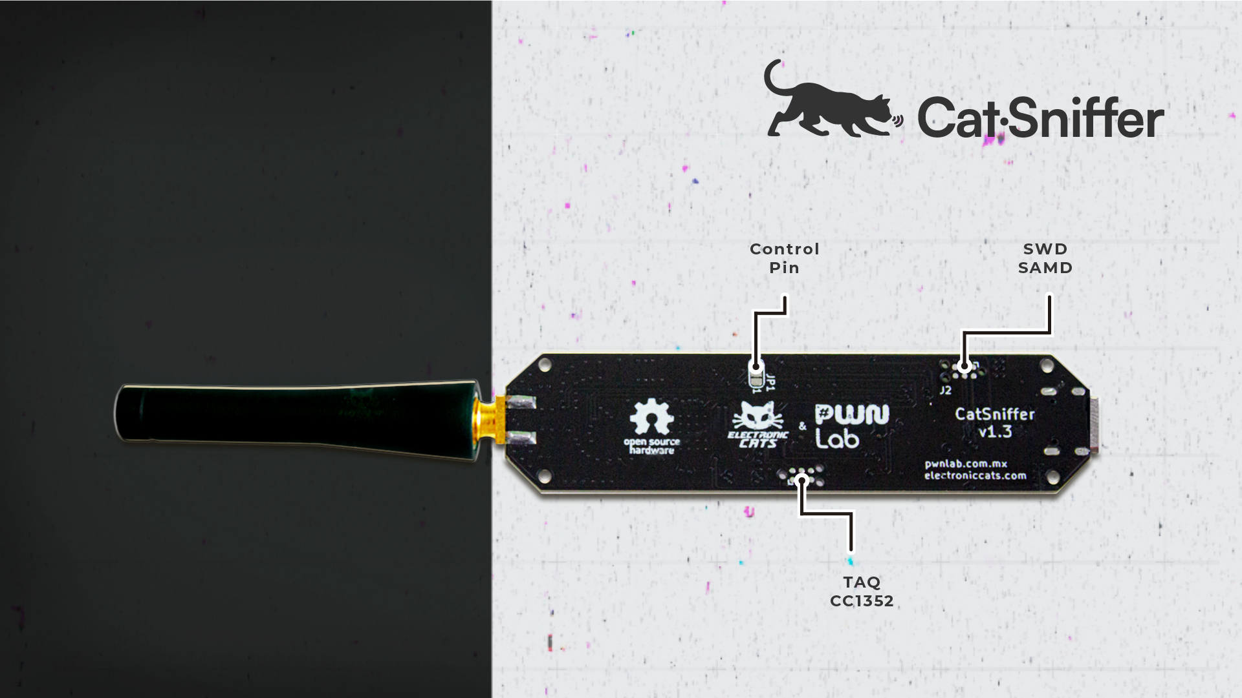
Supported software
This board is a Swiss army knife for IoT security researchers, developers, and enthusiasts. It's highly versatile, compatible with a wide array of software, including:
Packet Sniffers (*)
Security auditing tools
Custom firmware developed by ElectronicCats/PWNLab
(*) It works in Windows with the latest Wireshark!

Slide 7
Protocols
1.x/2.x
3.x
Thread
Zigbee
Bluetooth 5 Low Energy (BLE)
IEEE 802.15.4g
6LoWPAN (IPv6 over Low power Wireless Personal Area Networks)
Sub 1Ghz and patented systems
LoRa/LoRaWAN
Antenna support: 868/915 MHz up to 14 dBm, 2.4 GHz up to 20 dBm
RP2040 microcontroller
+Wi-SUN
+Amazon Sidewalk
+mioty®
Antena support: 433 MHz up to 13 dBm, 2.4 GHz up to 10 dBm

Slide 8
SPI
SX1262
RF Switch
USB
RP2040
Serial
CC1352P7
JTAG
GPIOs

Slide 9
Workshop prerequisites
To challenge yourself and follow along, you will need the following software (*):
Workshop booklet
https://bit.ly/44yWQsj
Code Composer Studio from https://www.ti.com/tool/CCSTUDIO
Code sources from https://github.com/ElectronicCats/CatSniffer/
Python3 (pyserial and other modules might be needed)
(*) It should be pre-installed in the Kali workstations but USBs with all the files should be available to copy the files to your machines!

Slide 10
Flashing firmware from Linux
To program your Catsniffer with one of the firmwares available:
Locate the desired firmware. You will usually find official firmwares in .hex format.
https://github.com/ElectronicCats/CatSniffer/tree/master/firmware
Put the CatSniffer in upload mode for the CC1352P7, press reset for the RP2040 and the boot for the CC1352, then release the reset button and second the boot button, you shall see an animation on the LEDs in the CatSniffer, you are ready to upload the desire firmware to the CC1352.
Locate the utility cc2538-bsl.py found in the Code folder.
Install the requirements for cc2538-bsl.py by issuing the following commands:
$python3 -m pip install pyserial
$python3 -m pip install intelhex
Reset the RP2040 once you have flashed the CC1352P
If you would like to read serial information from a terminal, put back the CatSniffer in serial passthrough mode with the correct speed using Arduino IDE. (Optional)

Slide 11
Practical examples
Follow along with booklet

Slide 12
Hands on Lab #1: Sniffing BLE

Slide 13
Learning objectives
Flash firmware for sniffing Bluetooth Low Energy connections
Basic usage of tools for analyzing BLE traffic
Packet structure of different types of BLE packets

Slide 14
Hands on Lab #2: Detecting personal trackers

Slide 15
Learning objectives
Learn about the technologies used in personal trackers
Learn how to detect personal trackers
Write custom firmware to detect personal trackers

Slide 16
Hands on Lab #3: Spoofing personal trackers

Slide 17
Learning objectives
Learn how to spoof personal trackers
Learn to craft custom BLE packets
Write firmware to communicate with devices over BLE

Slide 18
Questions?
Eduardo Contreras (e@electroniccats.com)
Paulino Calderon (paulino@pwnlab.mx)
Catsniffer on Github
https://github.com/ElectronicCats/CatSniffer
Download this workshop: https://bit.ly/3Dsyqol

